Slide 1


A Seismic Sensor based Human Activity Recognition Framework using Deep Learning
Paper ID: 72
Presenter: Priyankar Choudhary
Authors: Priyankar Choudhary, Neeraj Goel, and Mukesh Saini
Indian Institute of Technology Ropar, India

Slide 2
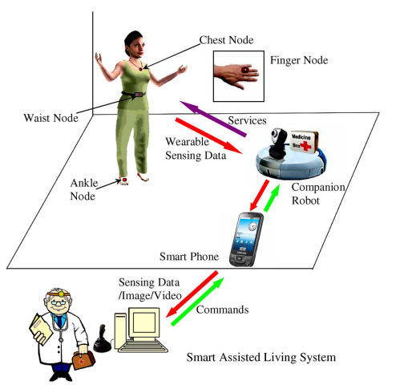
Introduction
Human activity recognition
Elder care (Fall detection)
Health care
Security
Gaming
Challenges
Requirement of support from user
Can not be deployed in some scenarios
Possible solution
Device-free applications
Image source: Zhu C, Sheng W. Wearable sensor-based hand gesture and daily activity recognition for robot-assisted living
Paper ID: 72
Notes:
Discuss HAR and its application, Tell limitation and possible solutions

Slide 3
Different device-free sensing modalities
Some of the available sensing modalities are as follows:
Video (Line-of-sight, processing, storage, privacy)^{[1]}
Audio (too sensitive to surrounding noise)^{[1]}
WiFi/ZigBee/Bluetooth (dedicated hardwares are required)
Passive Infrared (Temperature variations)
Seismic sensors are
Inexpensive, noninvasive, easy to install ^{[1]}, low power consumption, storage, and processing requirements
[1] Iyengar SG, Varshney PK, Damarla T. On the detection of footsteps based on acoustic and seismic sensing
Paper ID: 72

Slide 4
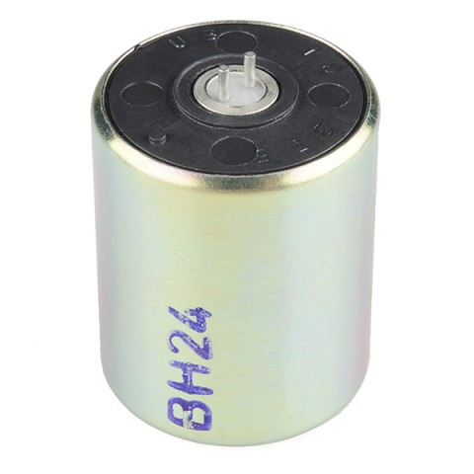


Dataset
SM-24 Geophone 1-Axis
Total Duration: 4 Hours
Ground: Hard surface with grass
Activities: Run, walk, jog, jumping jacks, jump, and no activity(noise)
10-14 meters
Sample data collection path
[1] http://cdn.sparkfun.com/datasheets/Sensors/Accelerometers/SM-24%20Brochure.pdf
Paper ID: 72

Slide 5
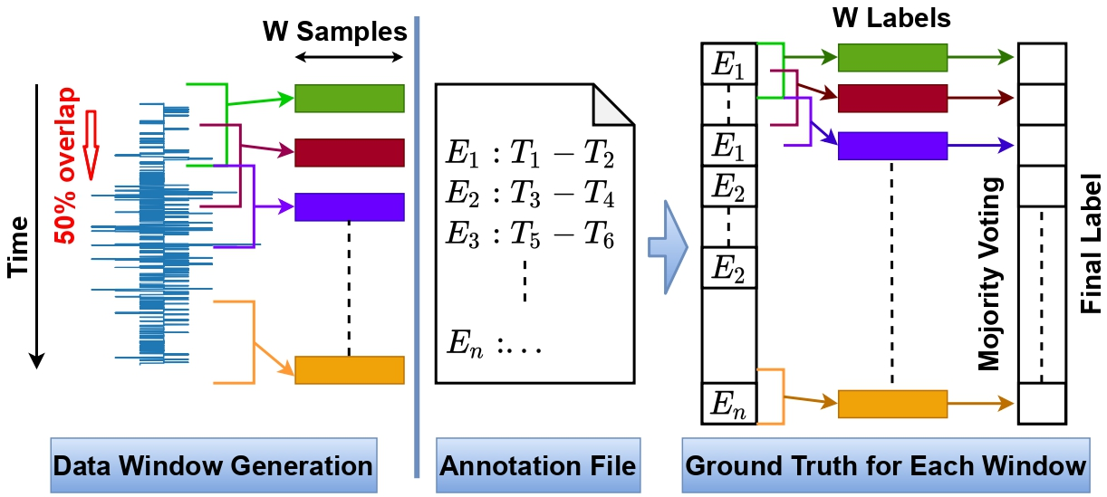
Data Preparation and Annotation
Paper ID: 72

Slide 6
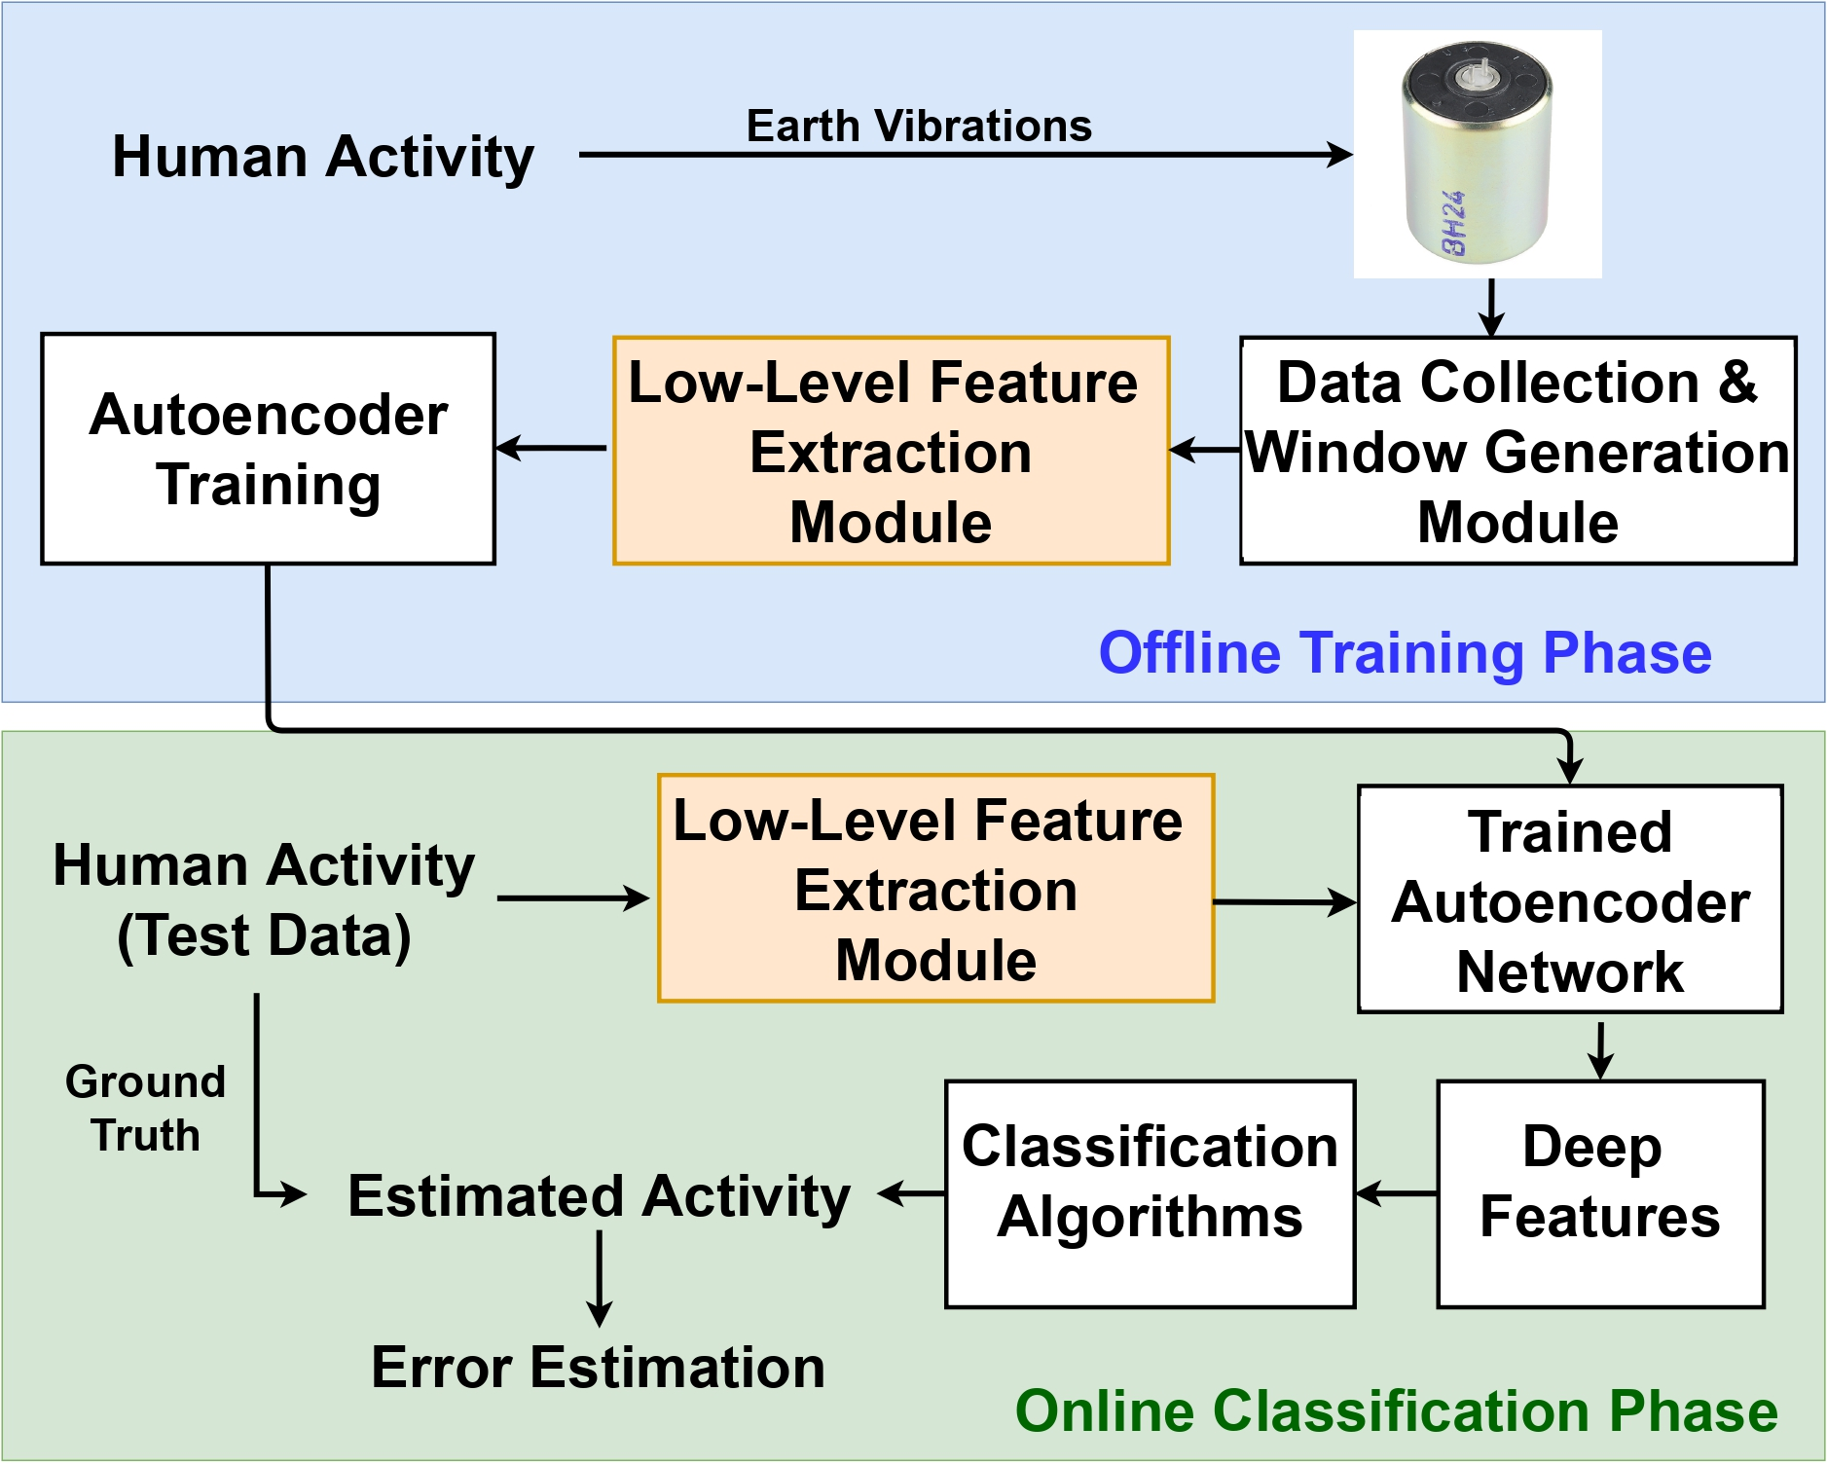
Proposed Work
Paper ID: 72
Features | Features
Mean | Kurtosis
Median | Skewness
Minimum | Absolute sum
Maximum | Interquartile range
Range | Standard deviation
Cepstrum | Absolute variance
FFT | Mean absolute deviation
Energy | Ratio of first and second peak
Abbas M, Elhamshary M, Rizk H, Torki M, Youssef M. WiDeep: WiFi-based accurate and robust indoor localization system using deep learning
Paper ID: 72

Slide 7
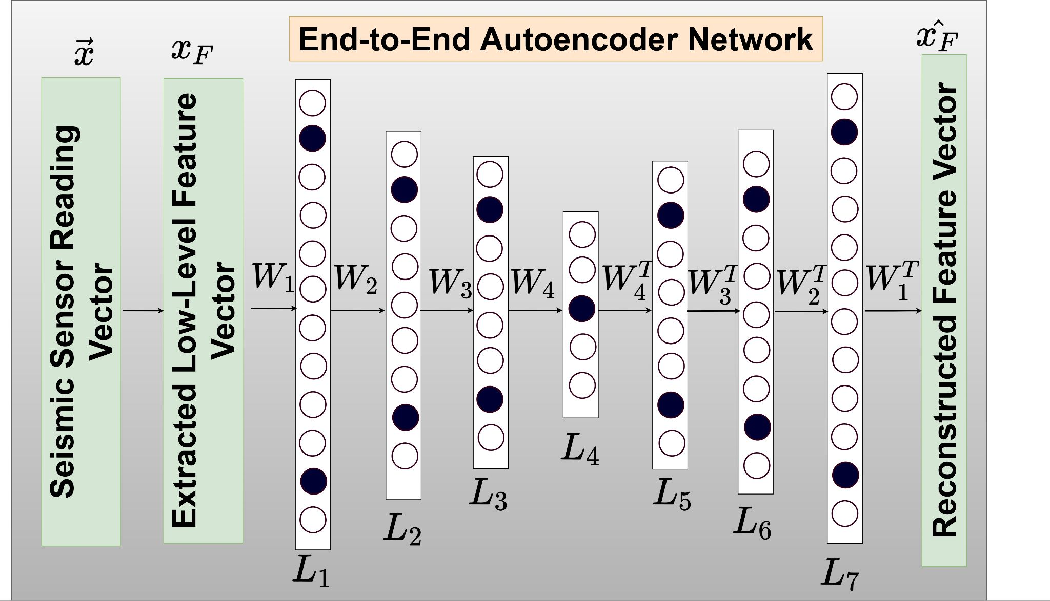
Proposed Work (Contd.)
Number of nodes in each layer
L1 = 400 L2 = 300
L3 = 200 L4 = 100
L5 = 200 L6 = 300
L7 = 400
Optimizer = Adam
Learning rate = 10⁻⁶
Activation = Relu
Dropout = 15%
Epochs = 100
Batch size = 16
Reconstruction Loss = Mean squared error
An end-to-end architecture of an autoencoder for feature extraction; black nodes indicate dropout regularization
Abbas M, Elhamshary M, Rizk H, Torki M, Youssef M. WiDeep: WiFi-based accurate and robust indoor localization system using deep learning
Paper ID: 72

Slide 8
Model performance
 | Noise | Run | Jog | Walk | J.Jacks | Jump
Noise | 3287 | 14 | 45 | 71 | 9 | 11
Run | 243 | 165 | 93 | 22 | 12 | 2
Jog | 45 | 55 | 285 | 52 | 2 | 0
Walk | 131 | 6 | 25 | 248 | 0 | 0
J.Jacks | 8 | 6 | 3 | 0 | 280 | 3
Jump | 8 | 0 | 0 | 0 | 5 | 26
True Labels
Precision
Confusion matrix
 | Noise | Run | Jog | Walk | J. Jumping | Jump | Average
KNN (K=21) | 0.861 | 0.539 | 0.530 | 0.565 | 0.892 | 0.361 | 0.624
SVM-Liner | 0.795 | 0.662 | 0.540 | 0.474 | 0.892 | 0.736 | 0.683
SVM-RBF | 0.782 | 0.643 | 0.483 | 0.492 | 0.871 | 0.000 | 0.545
Decision Tree | 0.866 | 0.486 | 0.396 | 0.375 | 0.834 | 0.178 | 0.522
Random Forest | 0.799 | 0.595 | 0.458 | 0.478 | 0.812 | 0.156 | 0.549
ANN | 0.883 | 0.668 | 0.635 | 0.634 | 0.910 | 0.620 | 0.725
S-SVM [5] | 0.742 | 0.585 | 0.713 | 0.000 | 0.783 | 0.848 | 0.611
S-KNN [5] | 0.838 | 0.439 | 0.598 | 0.533 | 0.813 | 0.713 | 0.655
Paper ID: 72

Slide 9
Model performance
 | Noise | Run | Jog | Walk | J.Jacks | Jump
Noise | 3287 | 14 | 45 | 71 | 9 | 11
Run | 243 | 165 | 93 | 22 | 12 | 2
Jog | 45 | 55 | 285 | 52 | 2 | 0
Walk | 131 | 6 | 25 | 248 | 0 | 0
J.Jacks | 8 | 6 | 3 | 0 | 280 | 3
Jump | 8 | 0 | 0 | 0 | 5 | 26
True Labels
Recall
Confusion matrix
 | Noise | Run | Jog | Walk | J. Jumping | Jump | Average
KNN (K=21) | 0.962 | 0.288 | 0.518 | 0.386 | 0.888 | 0.256 | 0.549
SVM-Liner | 0.981 | 0.181 | 0.543 | 0.028 | 0.918 | 0.094 | 0.457
SVM-RBF | 0.984 | 0.121 | 0.437 | 0.054 | 0.877 | 0.000 | 0.412
Decision Tree | 0.944 | 0.246 | 0.333 | 0.412 | 0.797 | 0.165 | 0.482
Random Forest | 0.986 | 0.156 | 0.403 | 0.076 | 0.874 | 0.037 | 0.422
ANN | 0.956 | 0.306 | 0.648 | 0.603 | 0.930 | 0.645 | 0.681
S-SVM [5] | 0.985 | 0.186 | 0.124 | 0.000 | 0.907 | 0.200 | 0.400
S-KNN [5] | 0.929 | 0.322 | 0.465 | 0.354 | 0.888 | 0.358 | 0.552
Paper ID: 72

Slide 10
Optimal Window Selection
Cadence^{[1]}
Walk 1.9 Hz
Run 2.79 Hz
Different activities can give higher recognition rate at different window lengths
[1] Damarla T, Mehmood A, Sabatier J. Detection of people and animals using non-imaging sensors.

Slide 11
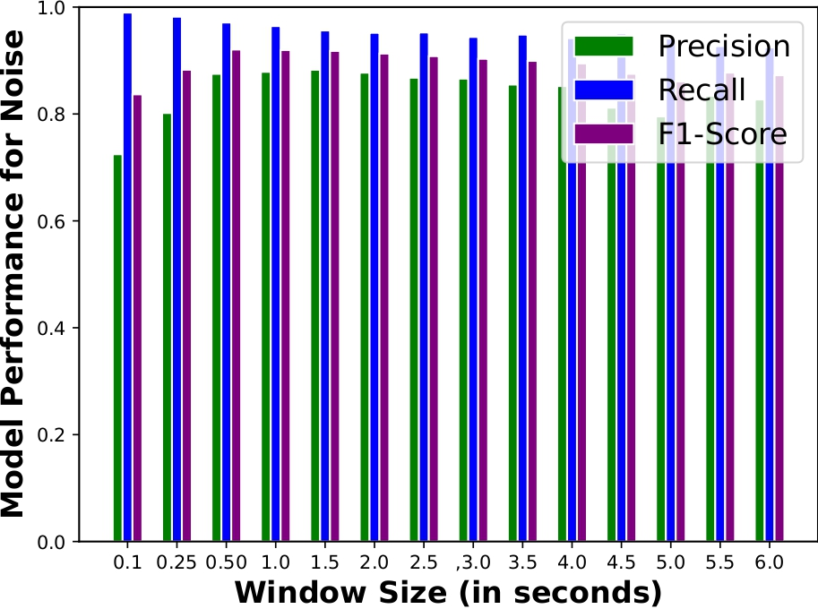
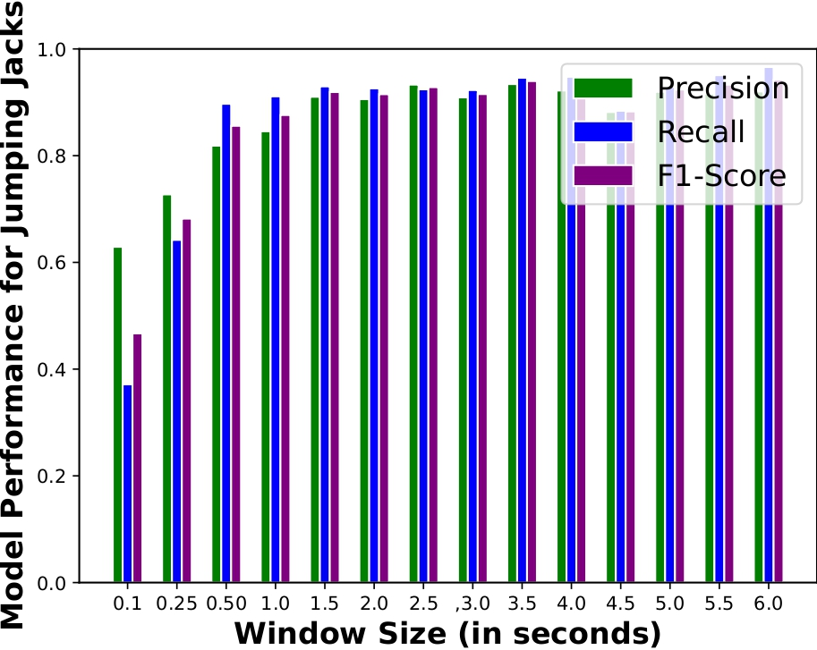
Optimal Window Selection
Inactivity (Noise)
Jumping Jacks
Paper ID: 72

Slide 12
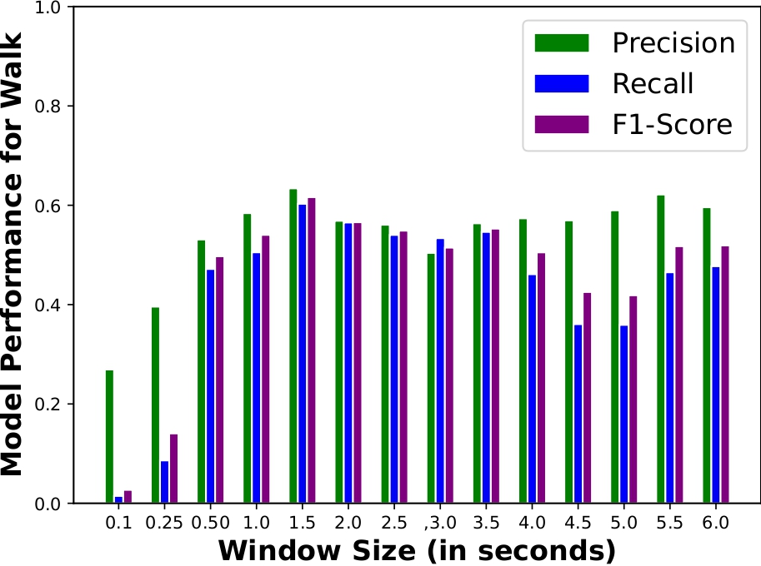
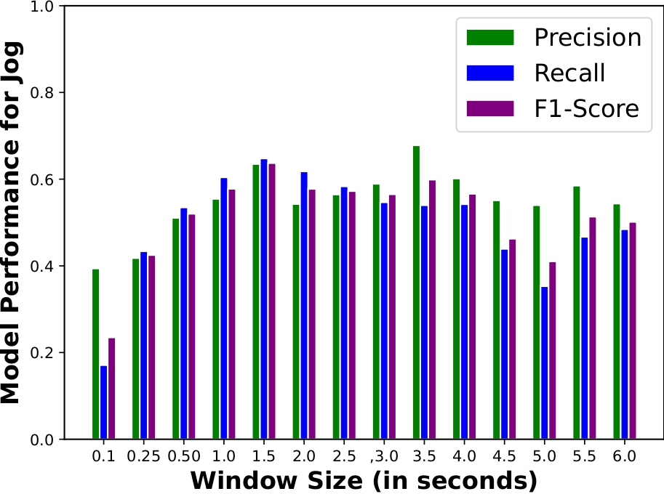
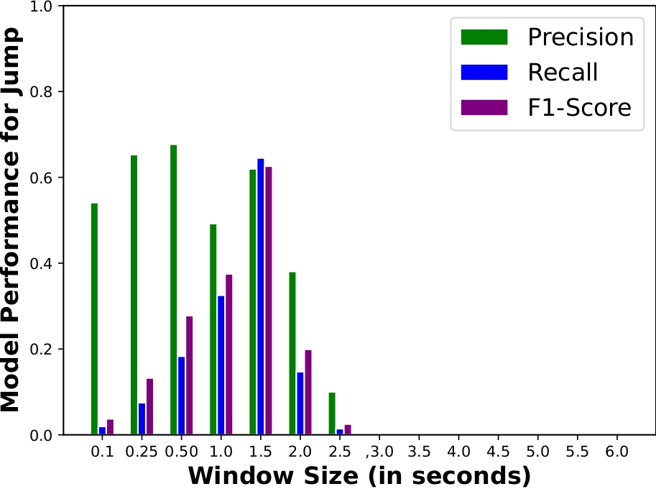
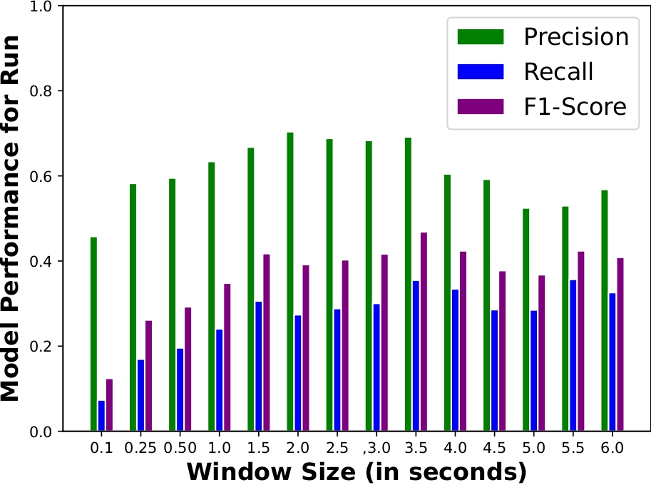
Optimal Window Selection
Jog
Walk
Run
Jump
Paper ID: 72

Slide 13
Optimal Window Selection
Jog
Walk
Run
Jump
Paper ID: 72

Slide 14
Conclusion
A window of length 1.5 or 2.0 seconds should be suffice for classifying targeted activities using seismic sensor data
ANN is a better classifiers than others for task of human activity recognition for targeted set of activities
Autoencoder helps to learn the better representation of data than handcrafted features.
Paper ID: 72

Slide 15
References
Damarla T, Mehmood A, Sabatier J. Detection of people and animals using non-imaging sensors. In14th International Conference on Information Fusion 2011 Jul 5 (pp. 1-8). IEEE.
Damarla R, Ufford D. Personnel detection using ground sensors. In Unattended Ground, Sea, and Air Sensor Technologies and Applications IX 2007 May 1 (Vol. 6562, p. 656205). International Society for Optics and Photonics.
Pucci L, Testi E, Favarelli E, Giorgetti A. Human activities classification using biaxial seismic sensors. IEEE Sensors Letters. 2020 Aug 31;4(10):1-4.
Zhu C, Sheng W. Wearable sensor-based hand gesture and daily activity recognition for robot-assisted living. IEEE Transactions on Systems, Man, and Cybernetics-Part A: Systems and Humans. 2011 Jan 10;41(3):569-73.
Abbas M, Elhamshary M, Rizk H, Torki M, Youssef M. WiDeep: WiFi-based accurate and robust indoor localization system using deep learning. In2019 IEEE International Conference on Pervasive Computing and Communications (PerCom 2019 Mar 11 (pp. 1-10). IEEE.
Paper ID: 72

Slide 16
Questions?

Slide 17
Related Literature
Classification of human and animal [1,2]
Biometric systems [3,4]
Classification of car, bicycle, run, and walk [5]
Classification of home activities [6]
Classification of vehicle types [7]
Paper ID: 72

